Slide 1
EMPLOYEE DATA ANALYSIS USING EXCEL
STUDENT NAME: R P MADHUMITHAA
REGISTER NO: 312210243
DEPARTMENT: B.COM (Accounting & Finance)
COLLEGE: GURU SHREE SHANTI VIJAI JAIN COLLEGE VEPERY CHENNAI 600118

Slide 2

EMPLOYEE DATA ANALYSIS USING EXCEL
PROJECT TITLE

Slide 3

AGENDA
Problem Statement
Project Overview
End Users
Our Solution and Proposition
Dataset Description
Modelling Approach
Results and Discussion
Conclusion

Slide 4

PROBLEM STATEMENT
Track employee performance rating overtime
Identify top performers and underperformers
Analyze performance by department, job role, and other categories
Visualize trends and correlations in performance data
Enable filtering and drill-down capabilities for in-depth analysis

Slide 5

PROJECT OVERVIEW
Effective employee performance management is crucial for organizations to achieve their goals and objectives.
This project will involve collecting and cleaning employee performance data, designing and developing an interactive Excel dashboard, and creating a user guide and data dictionary for easy adoption.

Slide 6
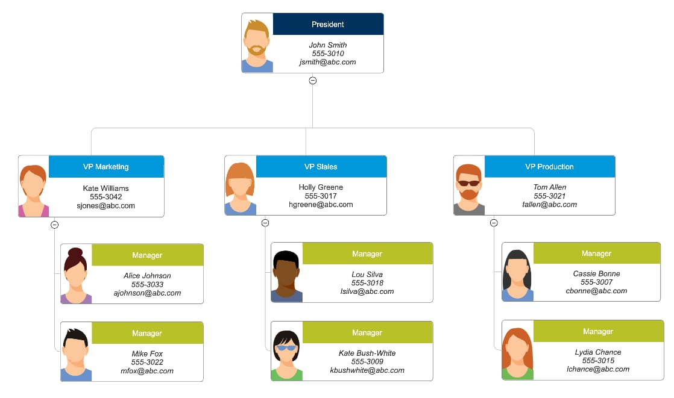
WHO ARE THE END USERS ?
HR Managers
Department Heads
Team Leads
Line Managers
Talent Management
Business Analysts
Executives

Slide 7
OUR SOLUTION AND ITS VALUE PROPOSITION
Conditional formatting – mission
Filter-Remove
Formula – performance
Pivot-summary
Graph-data visualization
Conditional formatting: Our Excel based Employee performance Analysis Solution utilizes Conditional formatting to provide a clear and intuitive visualization of Employee performance data.

Slide 8
Filter – Remove: By incorporating filtering and removal capabilities, our solution empowers HR managers and leaders to efficiently analyze and visualize employee performance data, driving informed decision-making and business success.
Formula – performance: By leveraging formulas and performance metrics in Excel, our solution provides a powerful and efficient tool for employee performance analysis enabling HR managers and leaders to make informed decisions and drive business success.

Slide 9
Pivot- summary: By leveraging pivot tables and summary reports in Excel, our solution provides a powerful and flexible tool for employee performance analysis, enabling HR managers and leaders to Make informed decisions and drive business success.
Graph-data visualization: By leveraging graphs and data visualization in excel our solution provides a powerful and intuitive tool for employee performance analysis, enabling HR managers and leaders to Make informed decisions and drive business success.

Slide 10
{}
DATASET DESCRIPTION
Employee=kaggle
26-features
9-features
Emp id-num
Name-text
Name-text
Emp type
Performance level
Gender- male female
Employee rating-num

Slide 11

THE “WOW” IN OUR SOLUTION
Performance level: =IFS(Z4>=5,"VERY HIGH",Z4>=4,"HIGH",Z4>=3,"MED",TRUE,"LOW")

Slide 12
MODELLING
Data collection
1)kaggale
2)Search employment performance dataset
3)Then download Employmen data
Feature collection
1) Feature identify
2) colour filled blank values
Data cleaning
1) Missing values identify
2) Missing values filterout

Slide 13
Performance level
1)Calculate performance level
2)Using formula
summary
1) open pivot table.
2) drag rows,cols,filters,values respectively businessunit,performance level, gender code, count of first name.
3) remove the blank option.
visulazation
1)put recommended graph
2)filterout the linear and exponential features
3)To get pie chart for our reference.

Slide 14
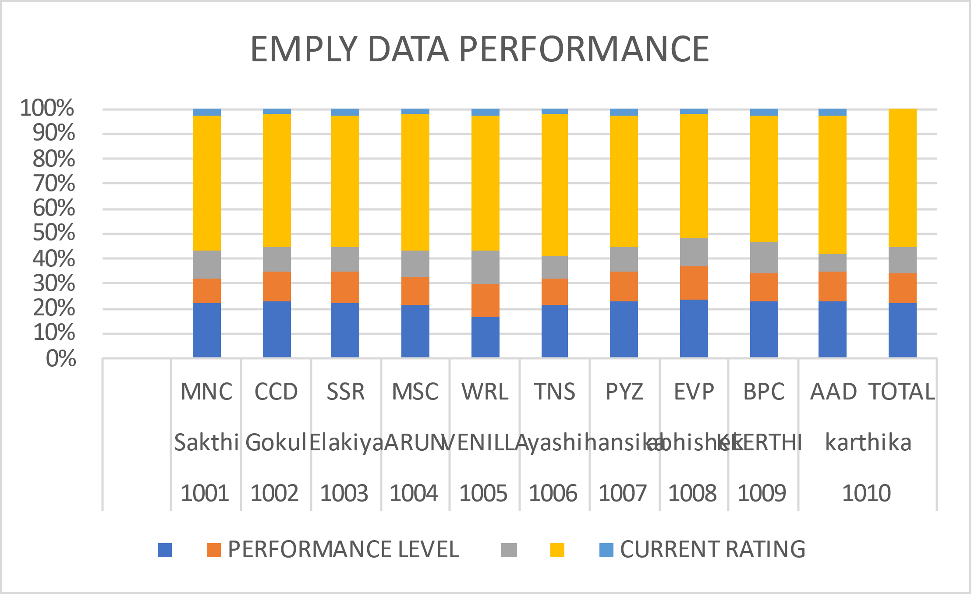
RESULT

Slide 15
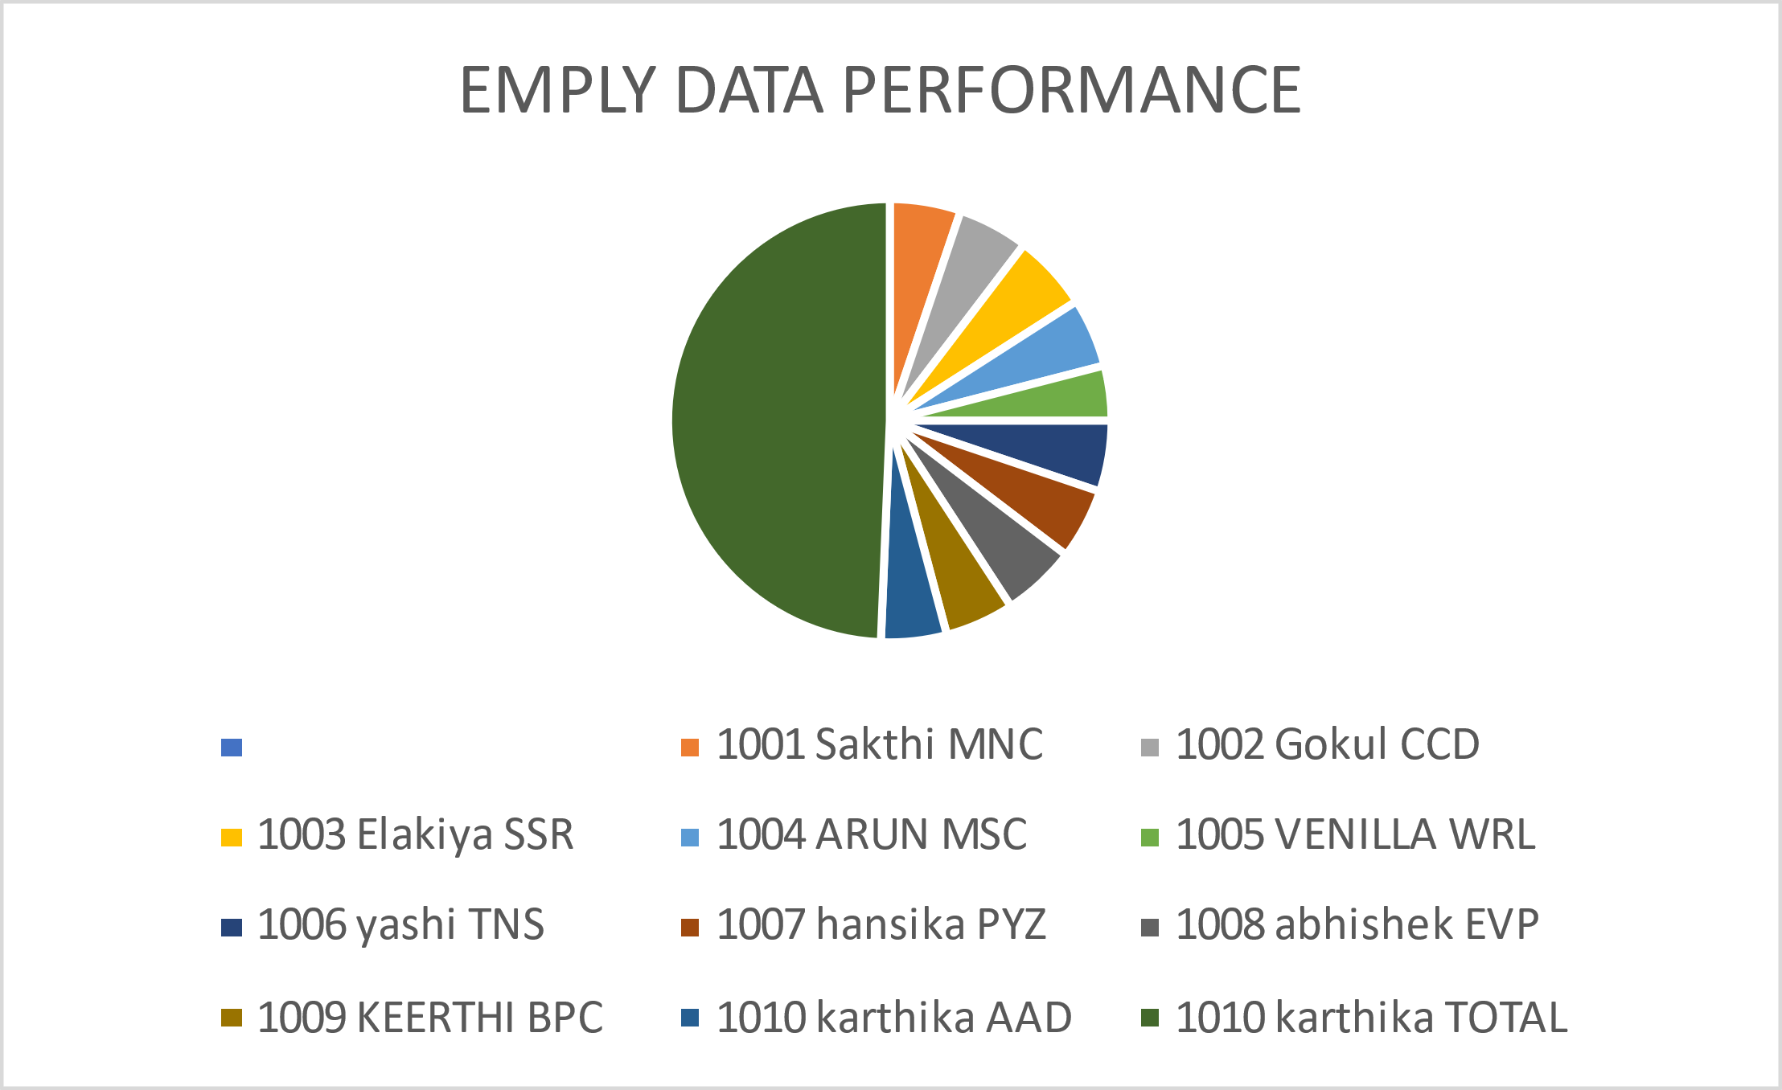
RESULT

Slide 16

CONCLUSION
Analyzing the employment performance dataset provides valuable insights into employee productivity,efficiency,and overall contribution to organizational goals.
Graphs play a crucial role in visualizing the data and useful for comparing individual employee performances.

